Slide 1
Interactive Path Reasoning on Graph for Conversational Recommendation

Slide 2
Conversational Recommendation System(CRS)
Conversational Recommendation Systems
|
|-- Single-round Recommendation Systems
| |
| |-- Content-based Systems
| |-- Collaborative Filtering Systems
| |-- Hybrid Systems
|
|-- Multi-round Recommendation Systems
|
|-- Collaborative Filtering Systems
| |
| |-- User-based Systems
| |-- Item-based Systems
|
|-- Content-based Systems
| |
| |-- Rule-based Systems
| |-- ML-based Systems
|
|-- Knowledge-based Systems
| |
| |-- Constraint-based Systems
| |-- CPR-based Systems (Graph Reasoning)
ask mutiple times
recommend once
ask mutiple times
recommend more than once

Slide 3
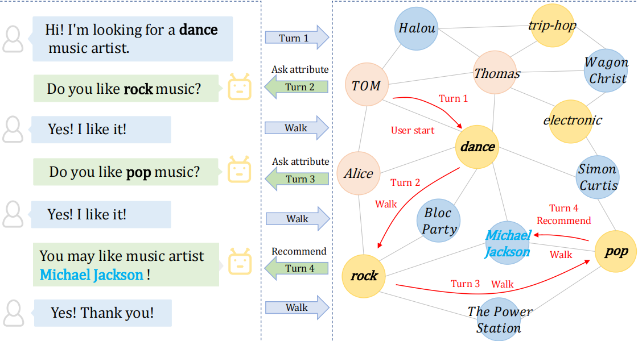
Method ：Conversational Path Reasoning (CPR)
Multi-round Conversational Recommendation
Graph
(Knowledge Graph)
CPR advantages:
Improved explainability
Efficient use of information
Dynamically capture user’s preference

Slide 4
SCPR : A Simpler Version of CPR
Reasoning
Transition
Consultation

Slide 5
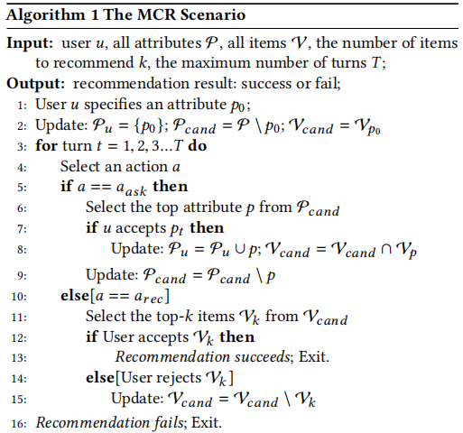
SCPR : A Simpler Version of CPR

Slide 6
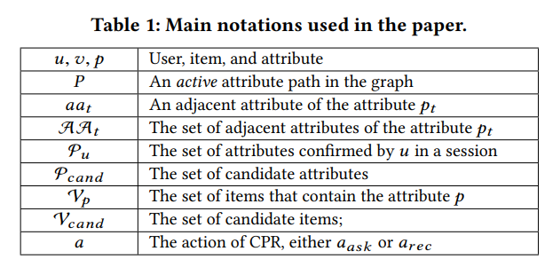
SCPR : A Simpler Version of CPR

Slide 7



Reasoning
p3
u
Pu={p0}
P_cand={all attributes \ p0}
s_p = {}
V_cand={v0,v1,v2,v3}
s_v = {sv0,sv1,sv2,sv3}
v2
p0
massage
v0
massage
p2
massage
v1
v3
p1

Slide 8

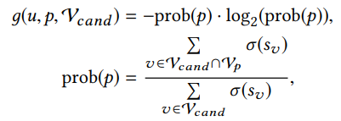
Reasoning
p3
u
massage
Pu={p0}
P_cand={p1,p2,p3}
s_p = {sp1,sp2,sp3}
V_cand={v0,v1,v2,v3}
s_v = {sv0,sv1,sv2,sv3}
v2
p0
massage
v0
p2
v1
massage
v3
massage
massage
p1

Slide 9
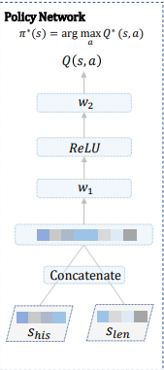
Consultation
action space:
a_ask
a_rec
conversational history
the size of V_cand

Slide 10
Consultation: if ask
action space:
a_ask
a_rec
p3
u
v2
p0
v0
p2
v1
Transition:
v3
p1
if user accepted p1:
Pu={p0}
P_cand={p1,p2,p3}
s_p = {sp1,sp2,sp3}
V_cand={v0,v1,v2,v3}
s_v = {sv0,sv1,sv2,sv3}
Pu={p0,p1}
P_cand={p2,p3}
s_p = {sp2,sp3}
V_cand={v3}
s_v = {sv3}

Slide 11
Consultation: if ask
action space:
a_ask
a_rec
p3
u
v2
p0
v0
p2
Transition:
v1
v3
p1
if user not accepted p1:
Pu={p0}
P_cand={p1,p2,p3}
s_p = {sp1,sp2,sp3}
V_cand={v0,v1,v2,v3}
s_v = {sv0,sv1,sv2,sv3}
Pu={p0}
P_cand={p2,p3}
s_p = {sp2,sp3}
V_cand={v0,v1,v2,v3}
s_v = {sv0,sv1,sv2,sv3}

Slide 12

Consultation: if recommend
action space:
a_ask
a_rec
p3
u
v2
p0
v0
p2
if user accepted v3:
succeed!!!!
else:
Transition:
v1
v3
p1
Pu={p0,p1}
P_cand={p2,p3}
s_p = {sp2,sp3}
V_cand={v3}
s_v = {sv3}

Slide 13
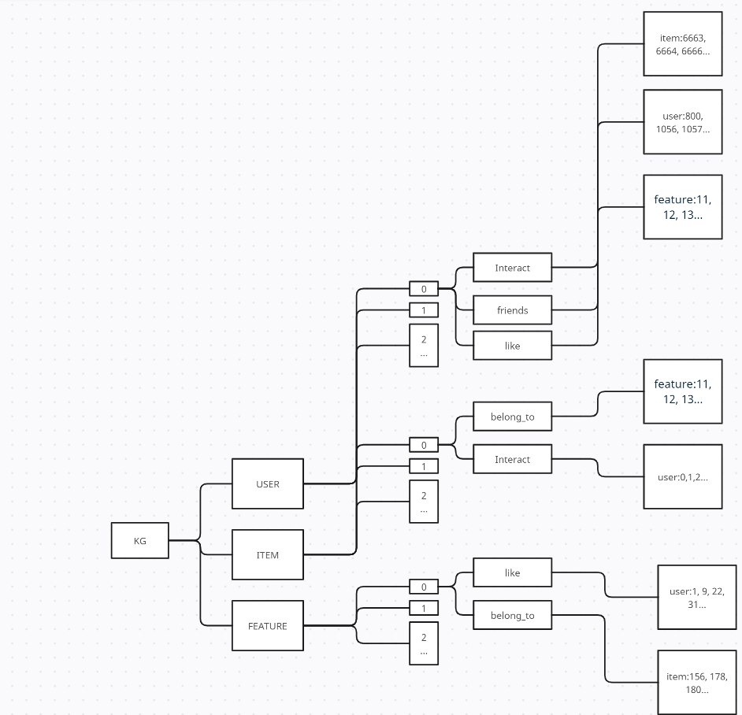
KG for LAST_FM_STAR

